Slide 1

Streamer breakdown mechanisms in air-gaps

Slide 2
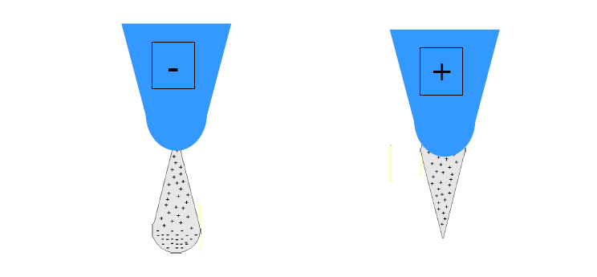
Corona discharges

Slide 3
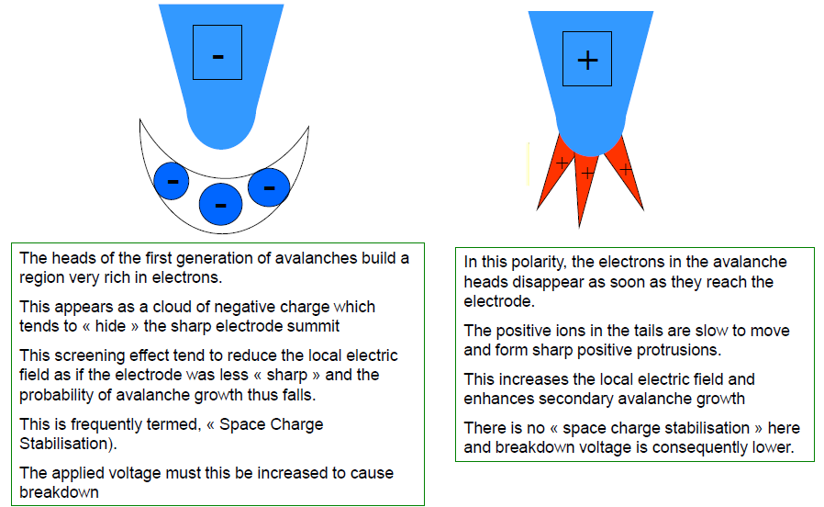
Negative and positive corona mechanisms

Slide 4
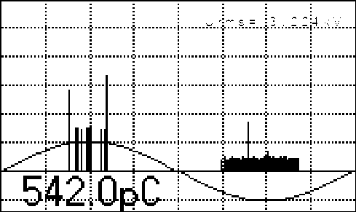
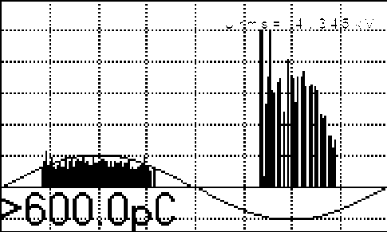
+ve corona
Trichel pulses

Slide 5
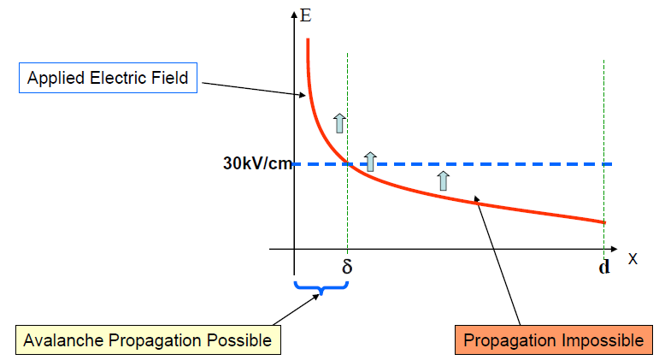
Case of localised avalanches in non-uniform fields (corona)

Slide 6
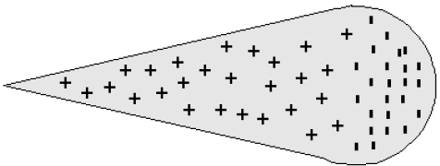
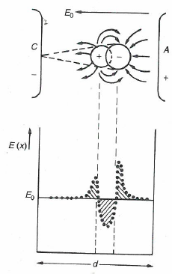
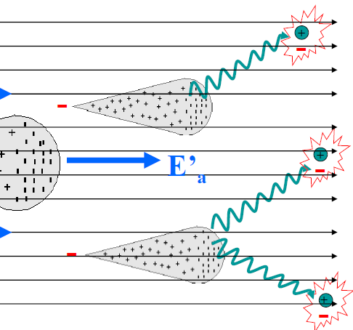

Streamer breakdown mechanism
-
Space charge distorted electric field
Primary avalanche (10⁸ electrons)
Satellite avalanches
Photo ionisation

Slide 7


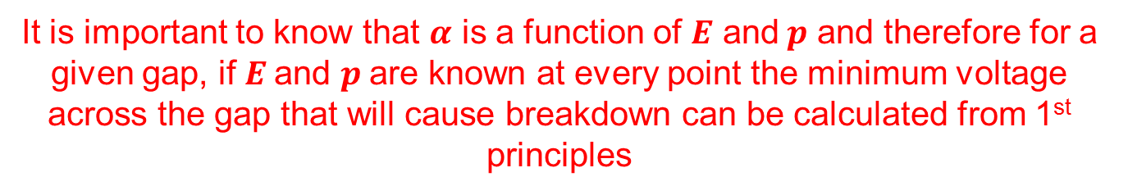
Conditions for streamer breakdown
The streamer breakdown avalanches become self sustaining if within the gap the following conditions are fulfilled:
10⁸ electrons in the avalanche head or
The e-field due to space charge on avalanche head equals background e-field
i.e. or
It is important to know that $α$ is a function of $E$ and$p$ and therefore for a given gap, if $E$and $p$are known at every point the minimum voltage across the gap that will cause breakdown can be calculated from 1st principles

Slide 8
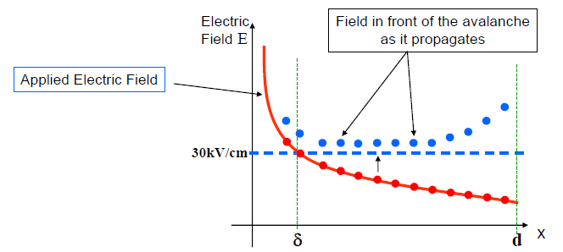
Auto-propagation of streamer avalanches

Slide 9
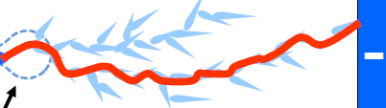
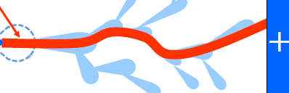
Streamer breakdown mechanism
-
-
Anode directed streamers (Raether)
Primary avalanche
Cathode directed streamers (Loeb & Meek)

Slide 10
Gap breakdown
-
Cathode directed streamers (Loeb & Meek)
Streamer propagates to breakdown in typical speeds of 0.1-10 meters per µs!
Anode directed streamers (Raether)

Slide 11
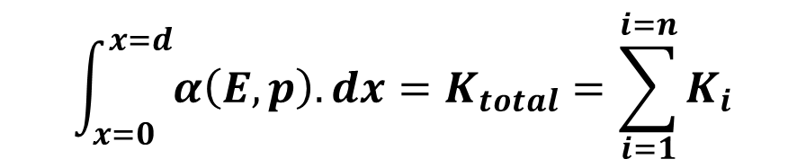
$$\int_{x=0}^{x=d}{α\left(E,p\right).dx}=K_{total}=\sum_{i=1}^{i=n}{K_{i}}$$
Where is d is in (mm) and (Ei) is in (kV/mm) and P in (bars)
$${In dry air: K}_{i}=1,6.x.{\left[E_{i}−2,2.P\right]}^{2}−0,3.P.x$$
$${In SF6: K}_{i}=27,9.x.\left[E_{i}−8,9.P\right]$$

Slide 12
Exercise problem

Slide 13
Factors influencing the breakdown voltage of an air gap
The gap size
The electrode geometry (and thus the electric field profile)
The air density (vis-a-vis altitude if exposed to the atmosphere), humidity and temperature
Type of voltage i.e. whether impulse (SI, LI), DC or AC.

Slide 14
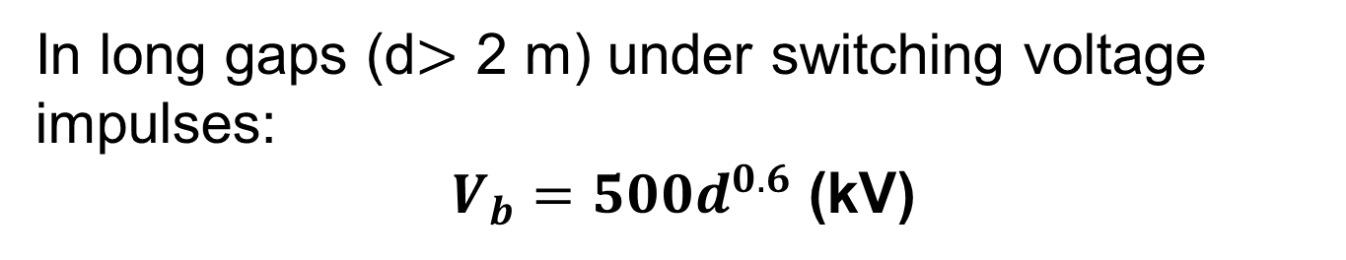
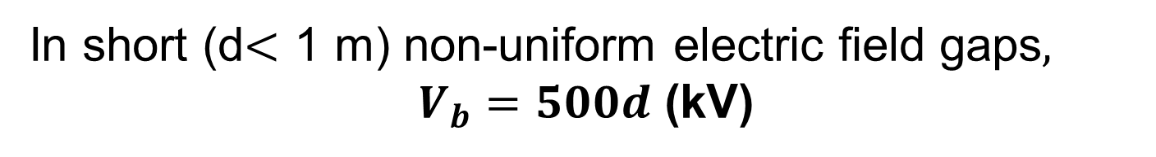
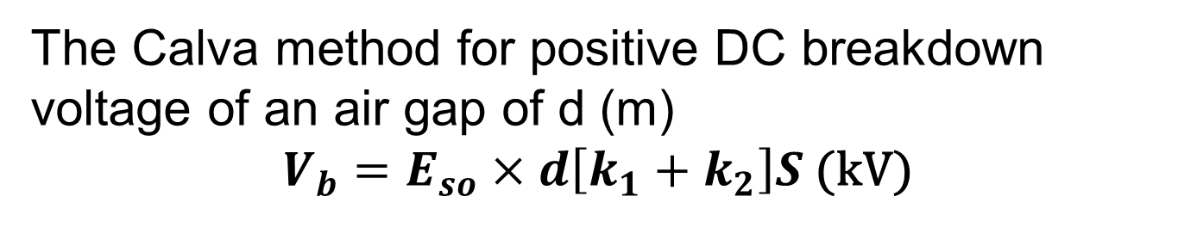
Other deterministic formulae for gap breakdown voltage calculation
In short (d$<$ 1 m) non-uniform electric field gaps$,$
$V_{b}=500d$ (kV)
In long gaps (d$>$ 2 m) under switching voltage impulses:
$V_{b}=500d^{0.6}$ (kV)
The Calva method for positive DC breakdown voltage of an air gap of d (m)
$V_{b}=E_{so}×d\left[k_{1}+k_{2}\right]S$ (kV)

Slide 15
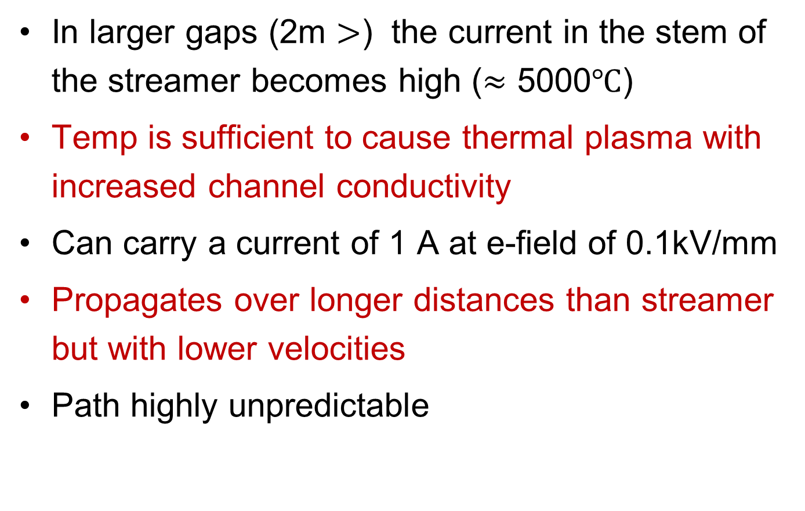
Leader transition in large gaps
In larger gaps (2m $>$) the current in the stem of the streamer becomes high ($≈$ 5000$℃$)
Temp is sufficient to cause thermal plasma with increased channel conductivity
Can carry a current of 1 A at e-field of 0.1kV/mm
Propagates over longer distances than streamer but with lower velocities
Path highly unpredictable

Slide 16
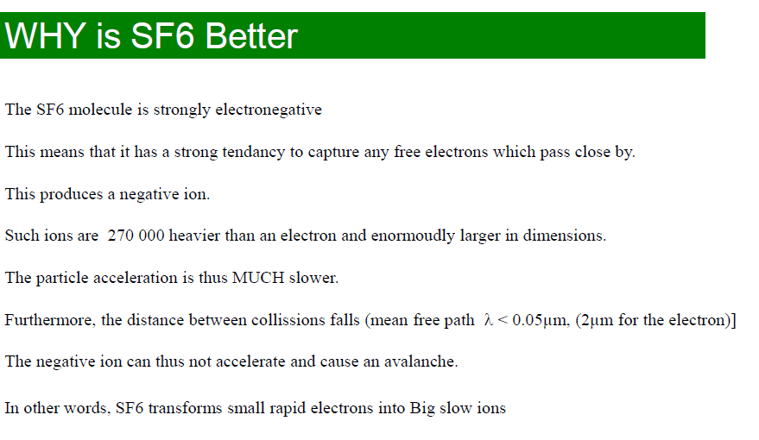

Slide 17
Comparison of Townsend and Streamer gas breakdown characteristics
Note: This table has been obtained from the text book, ‘Industrial High Voltage’ by F.H Kreuger, Delft University Press 1991
TOWNSEND | STREAMER
Low pd, examples: In general p.d. ≤ 10 atm.mm Internal discharges in solid material: air at 1 Bar in cavities of 10μm to several mms Gas at few mBars and large electrode distances in gas discharge tubes | High pd. Examples: In general p.d. ≥ 10 atm.mm Gas insulated equipment at several Bars and more than a few mms Atmospheric pressure and gaps over some cms
An initiating electron is required: Mechanism Accelerated electrons ionize gas atoms and cause electron avalanches Feedback by ions (and photons) striking the cathode, ϒ mechanism | An initiating electron is required: Mechanism Accelerated electrons ionize gas atoms and cause electron avalanches Feedback by photons hitting the nearest gas atoms
Cathode material: Affects the ϒ mechanism, thus the breakdown value | Cathode material: No effect
Shape: Diffuse light filling the available space | Shape: Filamentary bright channels, tortuous and branching at greater distances
Temperature: Low: a gas discharge tube can be touched by hand | Temperature: High: 5000 to 20000 ⁰C i.e. the temperature of the surface of the sun.
Time to breakdown: Order of μs | Time to breakdown: Order of 1 to 100 ns

